Slide 1

Project management
IC Platform KIM Jihyeok (JKM21)
9 Nov 2022

Slide 2
Project Managemet

Slide 3
Project management @business
Complexity challenges
Expectations
New models
Business
Faster
Smart systems
Data
Data
Worldwide
Customized
experience
Project
Product

Slide 4
Project management @business
Complexity challenges
50x
product data
19x
unstructured
data
225x internet of things data
Business
Data
Project
Product

Slide 5
Project management @business
Complexity challenges
35%
46%
19%
Business
On time/
budget
Challenged
Failed
Data
Project
Product

Slide 6
Project management @business
Separate systems
Requirements
Product data
Schedule
Resources
Scheduling conflicts
30% non-value
added activities
Reporting
Waiting
Costs
Errors
Productivity

Slide 7

Project management @business
사용하기 어려운 프로젝트 관리 시스템 환경
시스템을 통한 프로젝트 담당자 Assign 절차 미흡
비효율적인 산출물 등록
K사 현업 인터뷰 사례
시스템을 통한 일정 변경 관리 미흡
과제 및 이슈 정보를 여러 시스템에 등록하여 일원화 관리가 어려움

Slide 8

Project
Management

Slide 9
Dassault Systemes PMS Concept

Slide 10
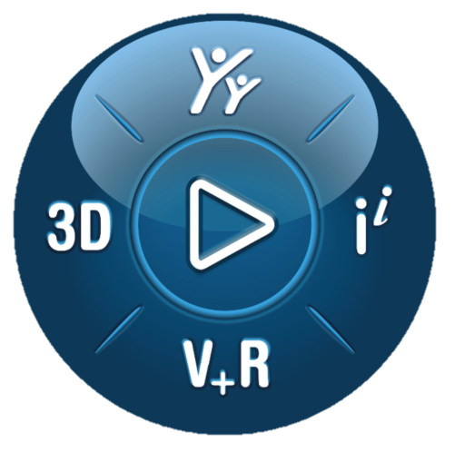
Project management system
Connected systems
Requirements
Project
Management
Invisible
Governance
Product data
Schedule
Project
Analytics
Resources

Slide 11
Project Management & Analytics
Product Data
Schedule
Collaboration
Collaboration
Visibility
Productivity
Visibility
Productivity
Alignment
Alignment
Invisible Governance
Project Analytics
Agility
Speed
Agility
Speed
Notes:
Collaboration
Rationaliser la communication, tout le monde travaillant ensemble sur la même définition, sur la même page vers un objectif commun
Productivity
Une seule définition multidisciplinaire avec des applications qui peuvent lire sur cette définition numérique pour que chacun puisse tirer parti et contribuer et améliorer la qualité globale et réduire les erreurs
Speed
Cette collaboration et cette productivité permettent d'accéder au marché plus rapidement qu'auparavant, avec une meilleure qualité
Agility
Conservez votre avantage concurrentiel à mesure que vous devenez plus apte à vous activer en cas de changement plus rapidement que jamais auparavant
Visibility
Informations en temps réel qui contribuent à une prise de décision efficace et accélérée
Alignment
De la stratégie à l'exécution, en passant par la communication des exigences et l'orchestration des changements, la plateforme vous aide à planifier et à exécuter votre définition du succès.

Slide 12
Project Management & Analytics
Product Data
Schedule
Collaboration
Collaboration
Visibility
Productivity
Visibility
Productivity
Alignment
Alignment
Invisible Governance
Project Analytics
Agility
Speed
Agility
Speed
Notes:
Speaker notes: recommend to focus on
Agility
Productivity
Collaboration
alignment

Slide 13
PMS | Product Data
How this impacts your day
What do I need
to work on?
Find
information
Provide updates
What’s the
deadline?
Messagerie
Emails
Where
is it?
Phone calls
Every project task
Every day
Everywhere

Slide 14
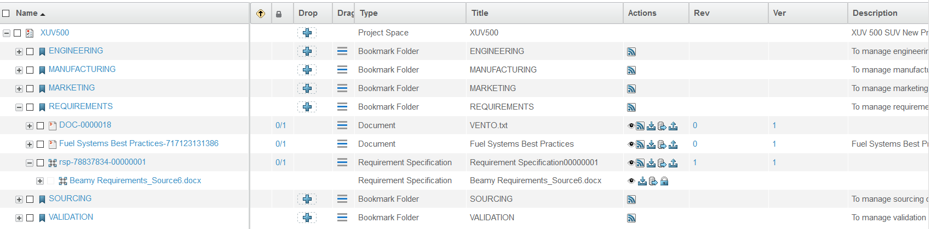
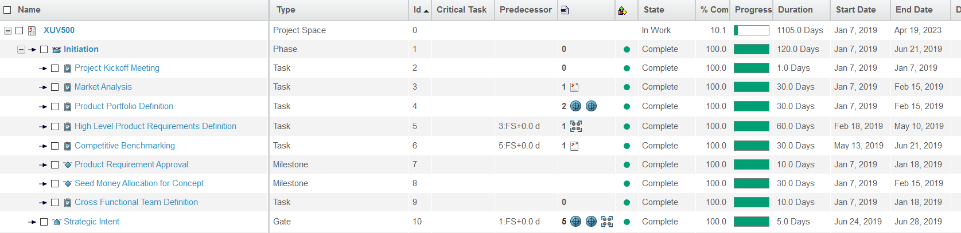
PMS | Product Data
Data-driven Projects
Bookmark
Folders
Collaboration
Requirements
Agility
Schedule
Visibility
Product Data
Alignment

Slide 15
Project Management & Analytics
Product Data
Schedule
Collaboration
Collaboration
Visibility
Productivity
Visibility
Productivity
Alignment
Alignment
Invisible Governance
Project Analytics
Agility
Speed
Agility
Speed
Notes:
recommend to focus on
Visibility
Collab
Speed
productivity

Slide 16
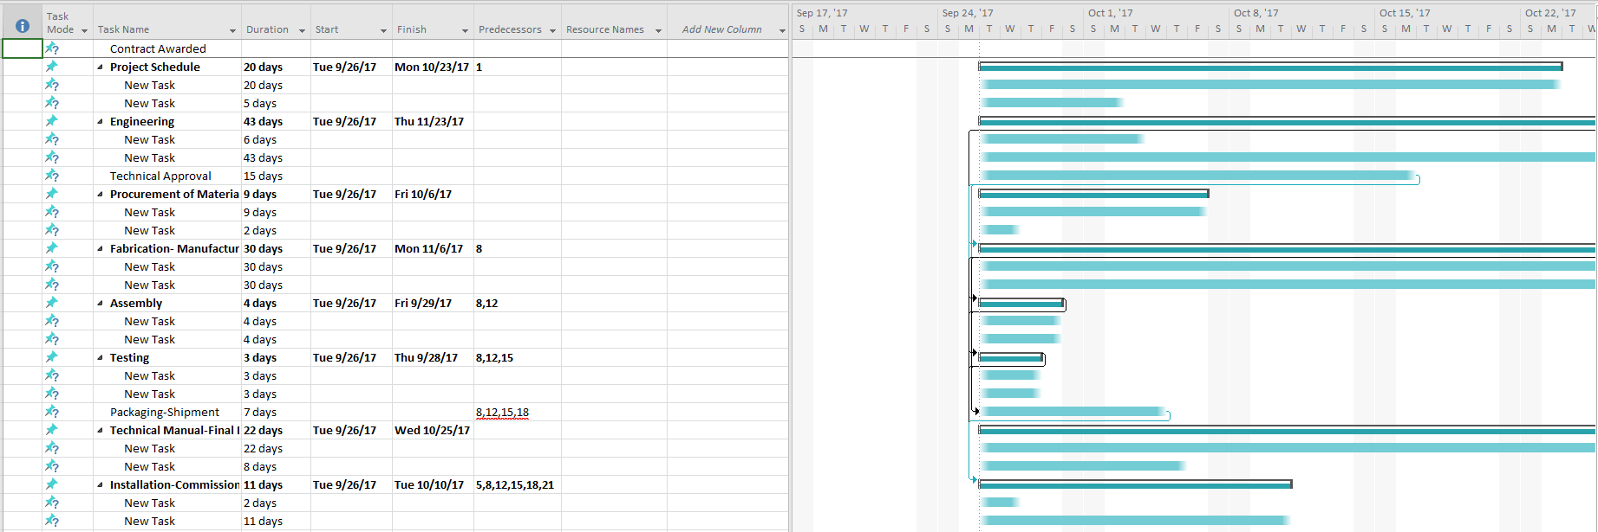
PMS | Schedule
Traditional File Based Approach
Static
Many copies
Manual update
Out of date

Slide 17
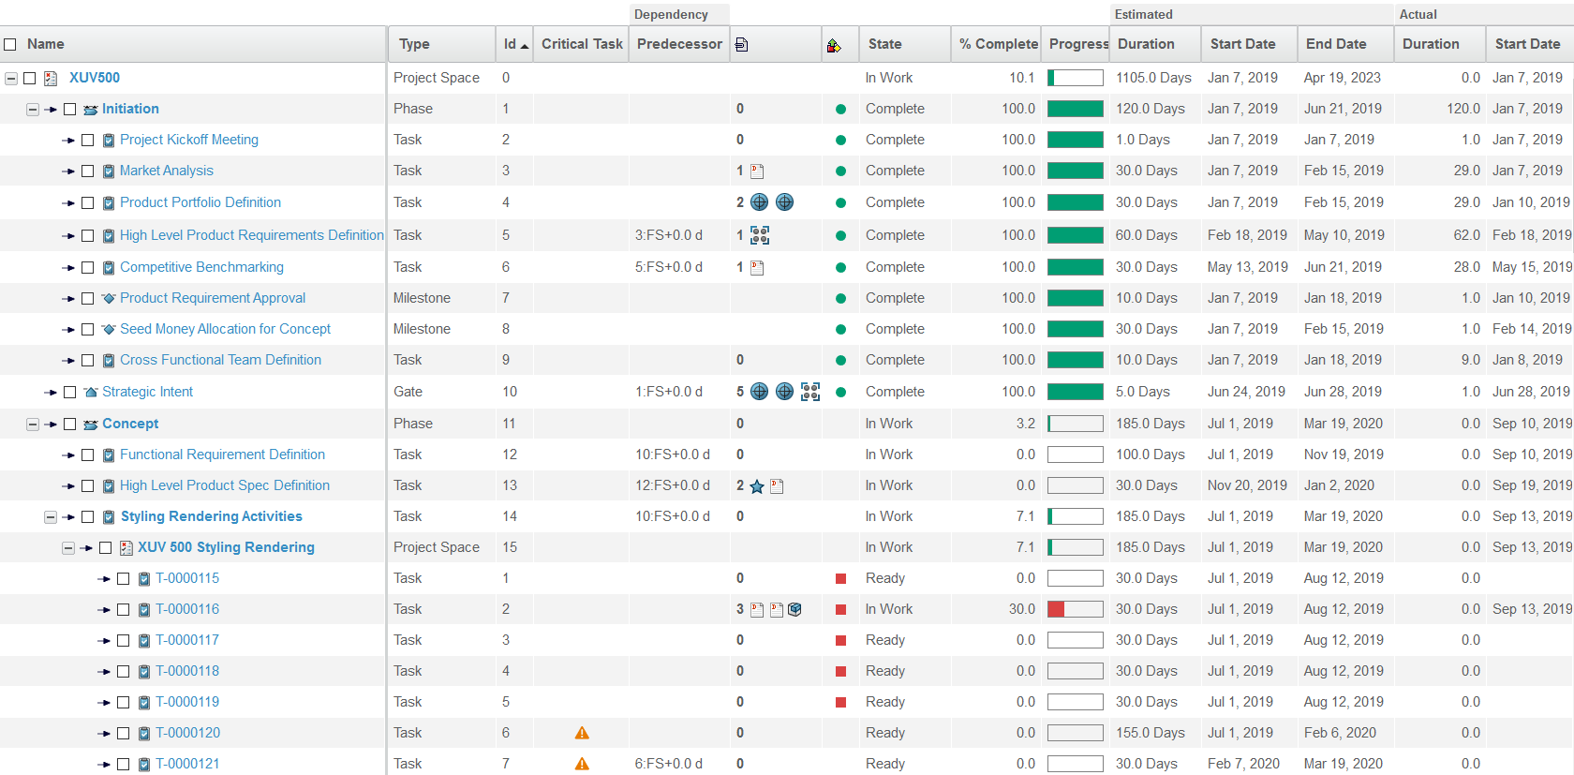
PMS | Schedule
Centralized, Live Schedule
Phase
Milestone
Gate
Dependency
Task
Critical Path

Slide 18
PMS | Schedule
Connected and Updated in Real Time
State
Dates
Deliverables
Sub-project
% Completion

Slide 19
PMS | Schedule
Connected and Updated in Real Time
State
Dates
Static
Dynamic
Many copies
Online
Manual update
Data driven
Out of date
Real time
Deliverables
Sub-project
Visibility
Collaboration
Productivity
% Completion

Slide 20
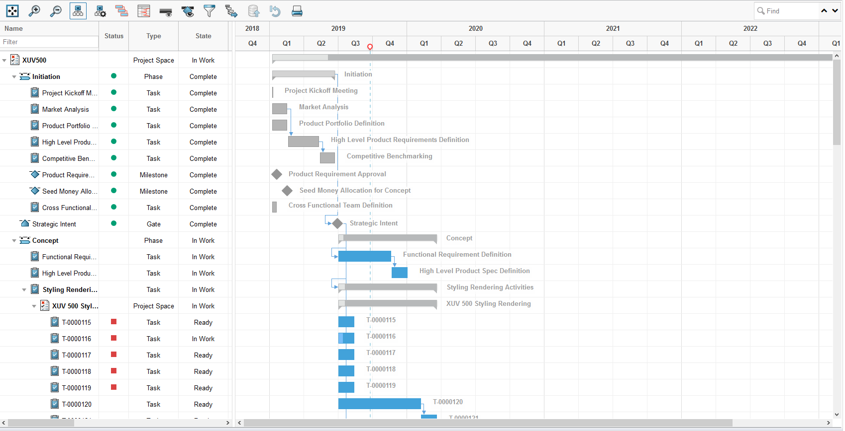
PMS | Schedule
Digital Data-driven Approach

Slide 21
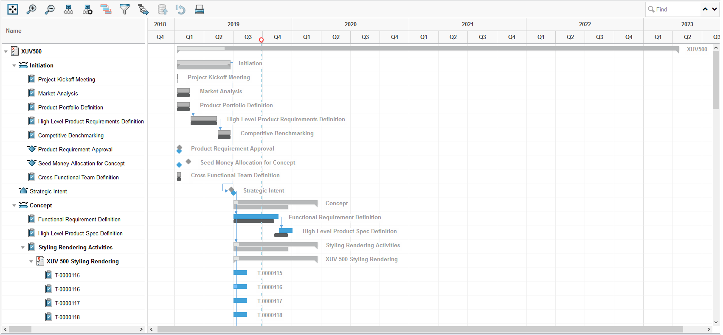
PMS | Schedule
Compare Plans with Execution
`

Slide 22
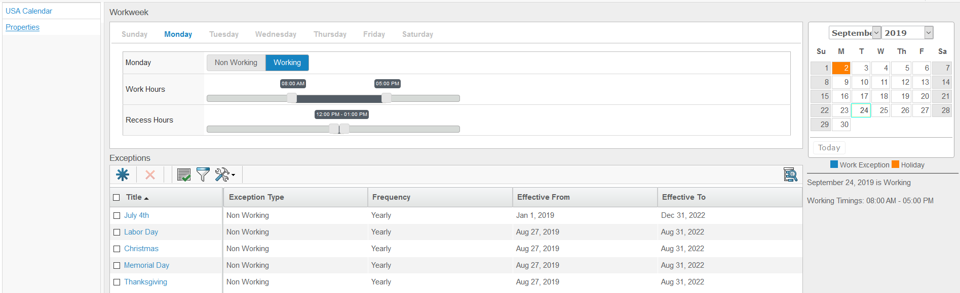
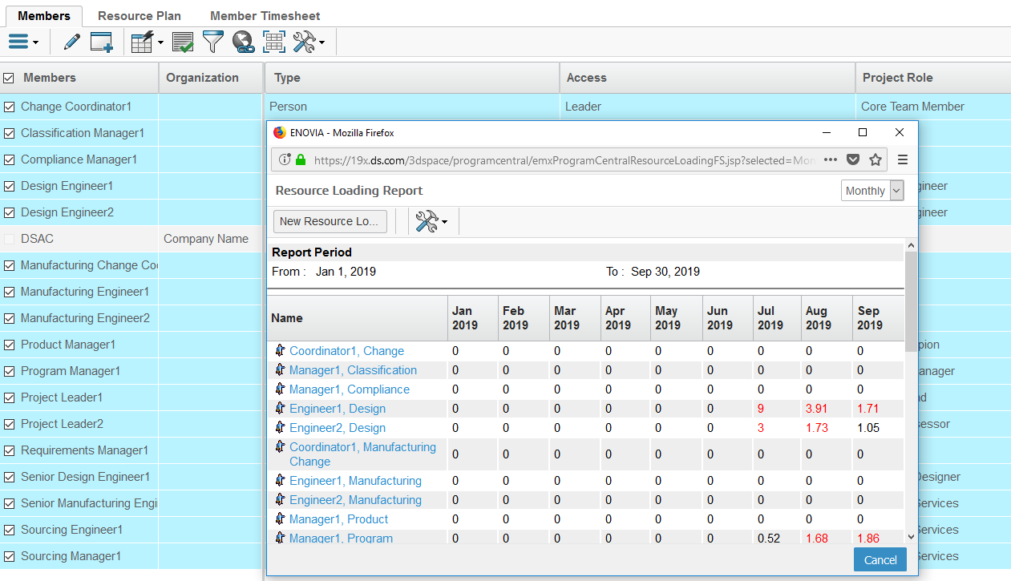
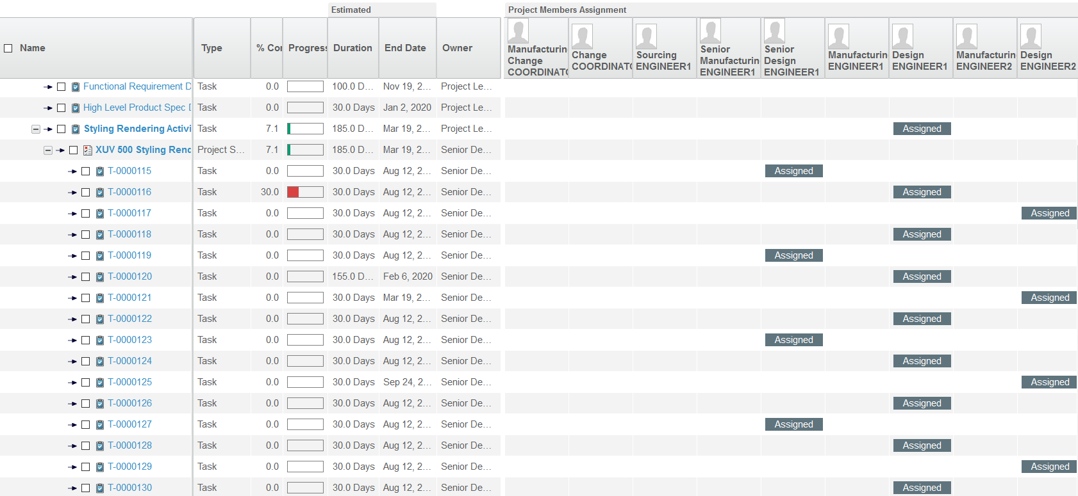
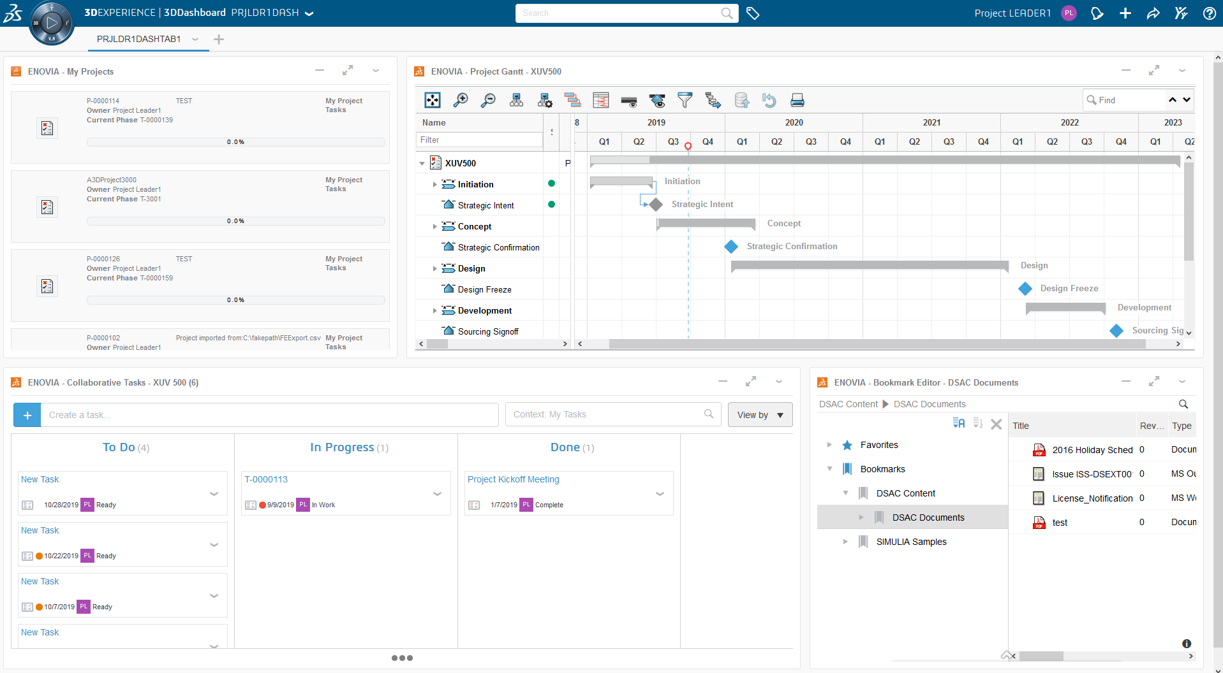
PMS | Schedule
Assigning Resources

Slide 23
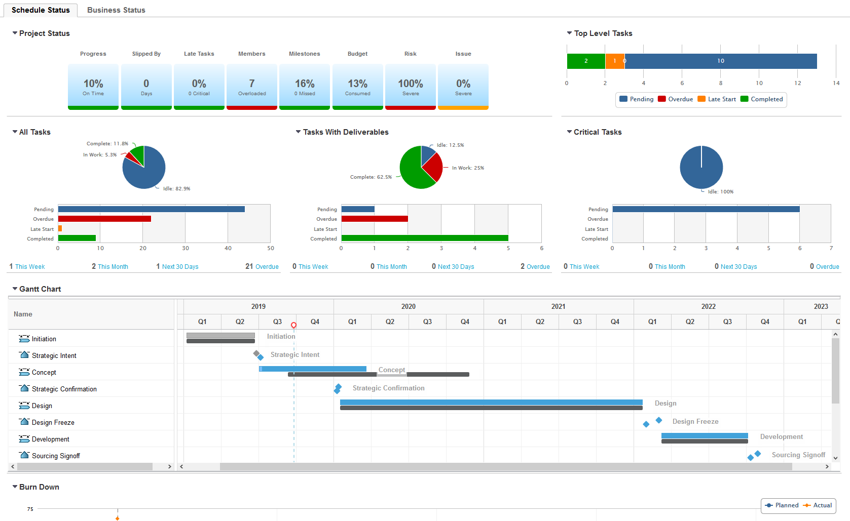
PMS | Schedule
Schedule Status
Resources
Scope
Schedule

Slide 24
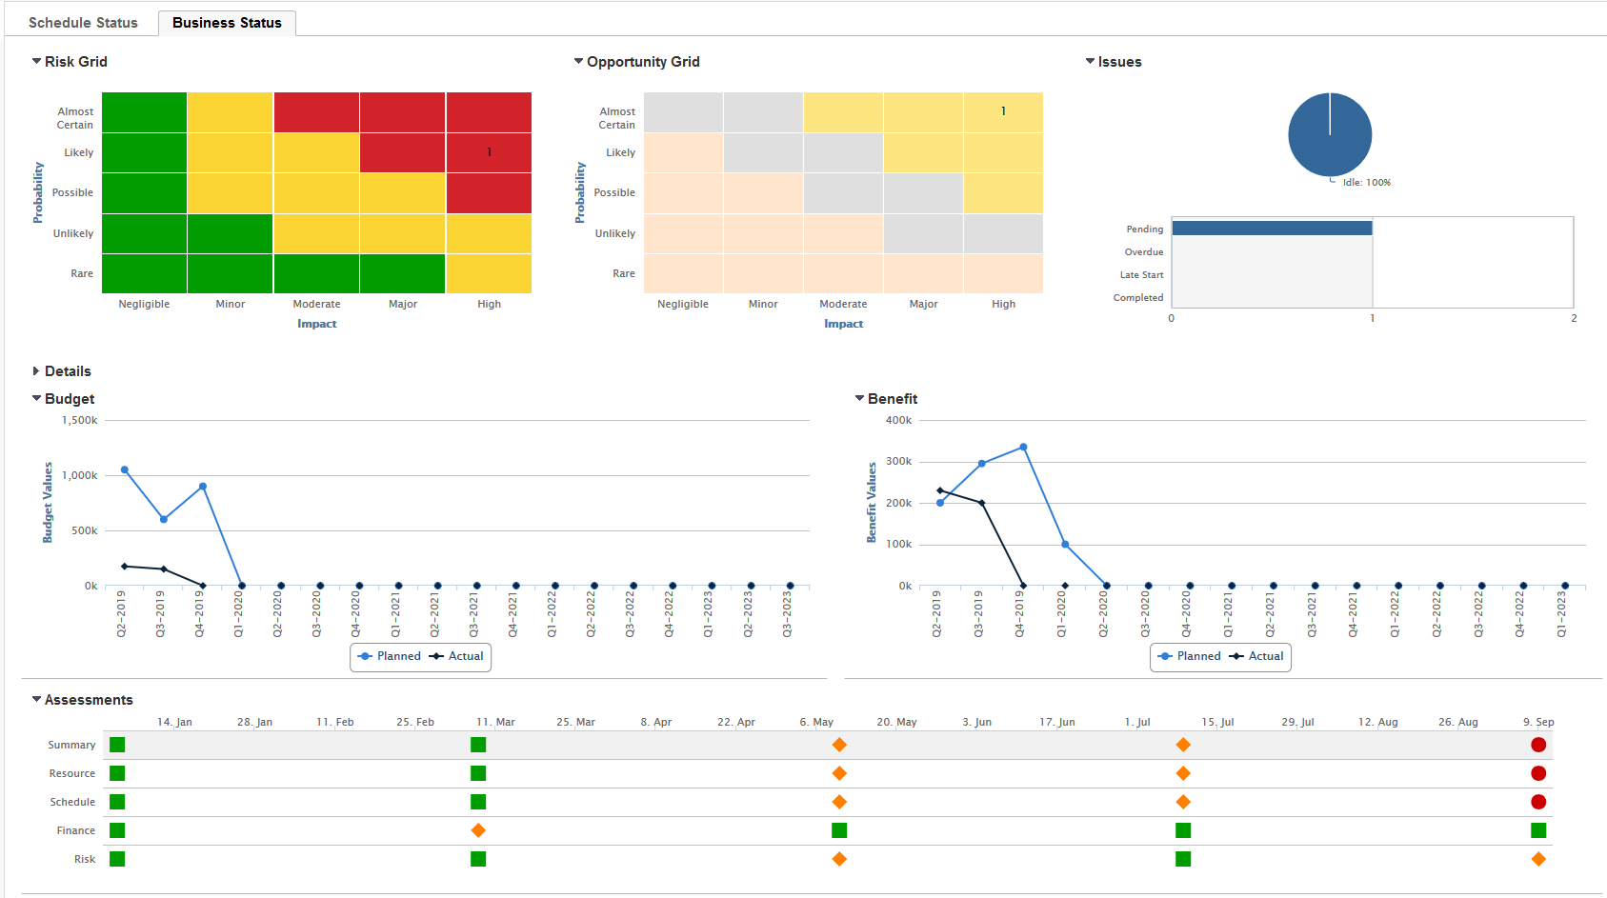
PMS | Schedule
Business Status
Issues
Risks
Opportunities

Slide 25
Project Management & Analytics
Product Data
Schedule
Collaboration
Visibility
Productivity
Alignment
Invisible Governance
Project Analytics
Agility
Agility
Speed
Speed
Notes:
focus on
Visibility & productivity

Slide 26
PMS | Invisible Governance
Manual Tracking of Project Status
Discovery
Gate 1
Stage 2
Gate 2
Stage 3
Manual & perception-based updates
45%
60%
75%
100%

Slide 27
PMS | Invisible Governance
Real-time dashboard reports
Invisible Governance
Discovery
Gate 1
Stage 2
Gate 2
Stage 3
Automatic & fact-based updates
45%
60%
75%
100%
In work
Frozen
Review
Released
In work
Frozen
Review
Released

Slide 28
Project Management & Analytics
Product Data
Schedule
Collaboration
Visibility
Productivity
Alignment
Invisible Governance
Project Analytics
Agility
Agility
Speed
Speed
Notes:
Focus on visibility and productivity

Slide 29
PMS | project analytics
Analytics in the Innovation Process
Know how
Information
Data

Slide 30
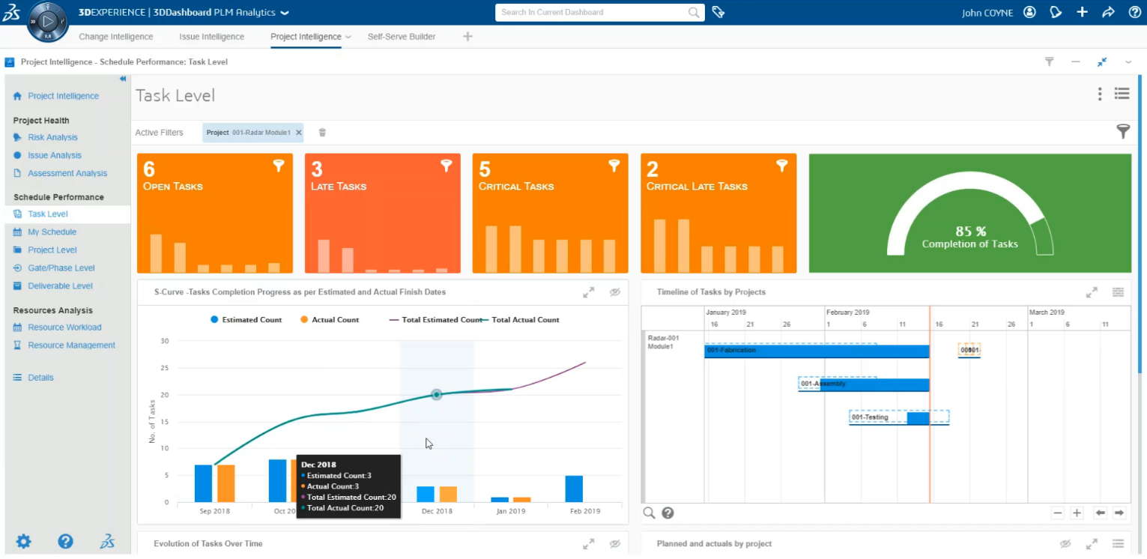
PMS | project analytics
Project Analytics
What happened?
Why did it happen?
External data
Continuous Improvements

Slide 31
Project Management & Analytics
Product Data
Schedule
Collaboration
Visibility
Productivity
Alignment
Invisible Governance
Analytics
Agility
Agility
Speed
Speed
Notes:
Collaboration : plusieurs équipes travaillant sur le projet en tant que centre
Visibilité : les modifications du calendrier sont instantanées
Alignement : dépendances ; à partir de modèles, les sous-projets sont tous intégrés dans des jalons principaux
Productivité : pas de vérification des fichiers statiques du calendrier du projet et d'envoi de la dernière version à toute l'équipe - calendrier numérique en direct qui élimine les erreurs

Slide 32
Hands on

Slide 33
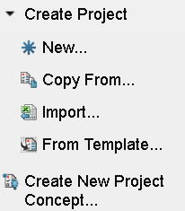

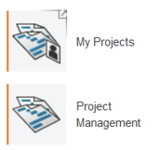
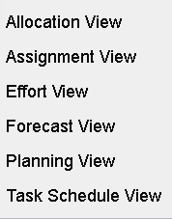
Project schedule
Schedule Project Activities
General overview on how Creating Projects
Modify a New Project
Collaborative Tasks
Add Project Members and Task Assignees
1
2
3
4
Phase, Task, Gate, Milestone
Define Task Dependency
Team Members and Project Manager determine Assigned Tasks….
Manage Assignment
Modify the Project
5
Create Project Bookmarks
Add Deliverables
Define the Budget
Continue in the next Slide
8
7
6
Analyze Projects
Dashboard Views
Project Views
Across organizations
Assess performance KPIs
Select best path through scenario comparison
Schedule Status
Gantt Chart
Milestones
Phase Gate View
Baselines

Slide 34
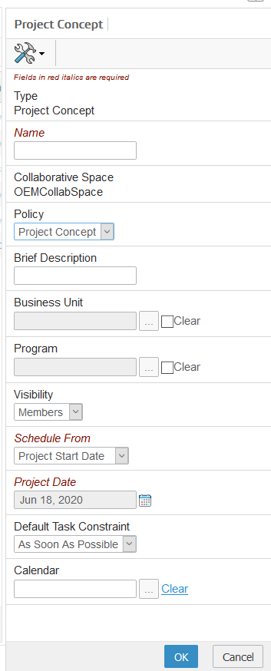
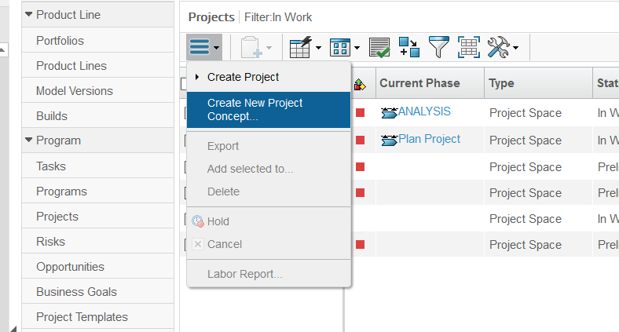
Create new Project Concept
Project Concept (1/4)

Slide 35
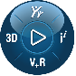
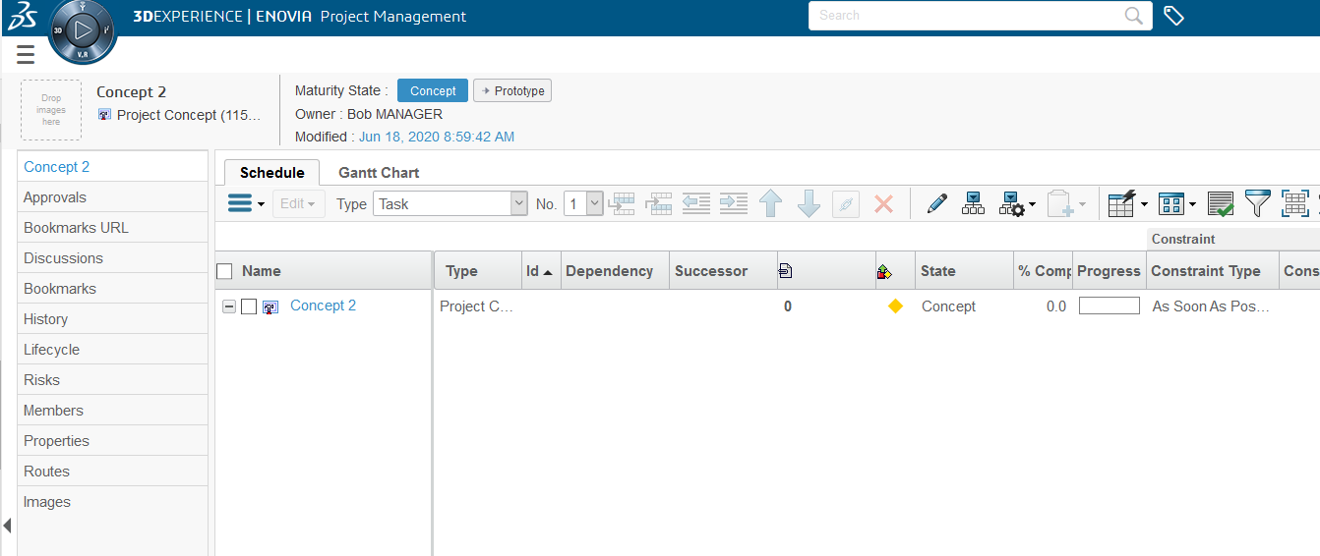
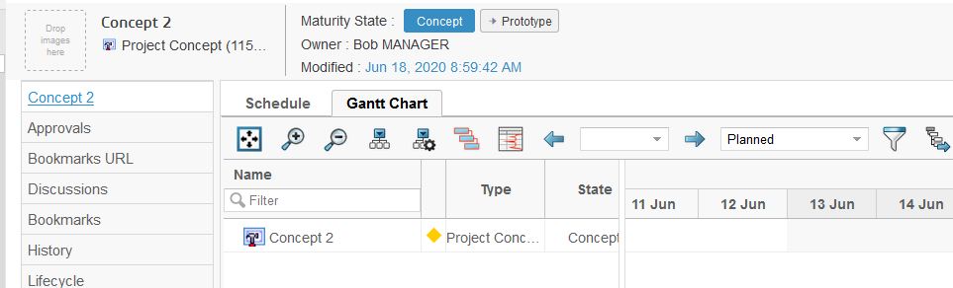
Create new Project Concept
Project Concept (2/4)

Slide 36
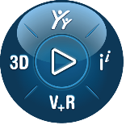
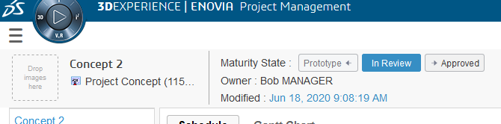
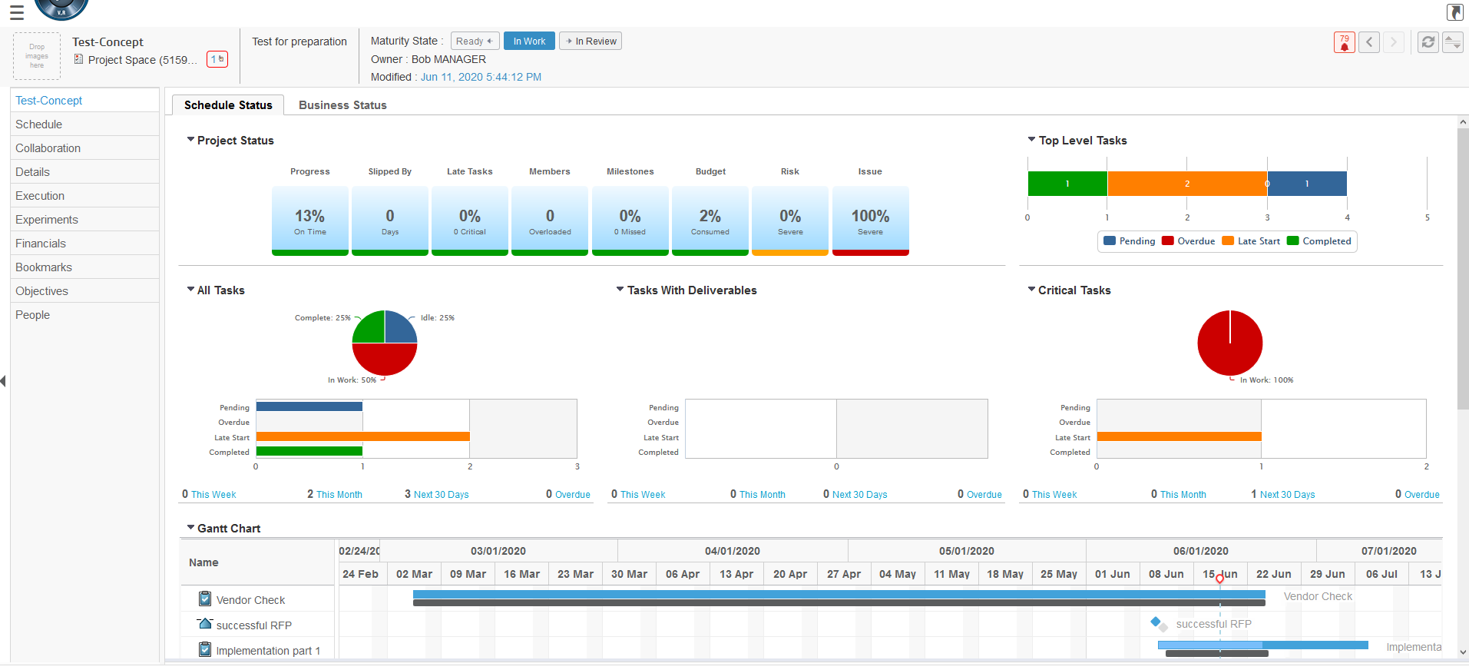
Create new Project Concept
Promote Project Concept (3/4)
promote Project Concept until it becomes a project, combination with Routes-application possible

Slide 37
Create new Project Concept
Project Concept promoted to Project (4/4)

Slide 38
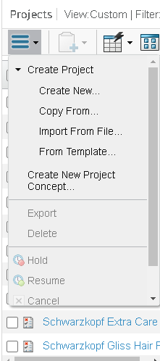
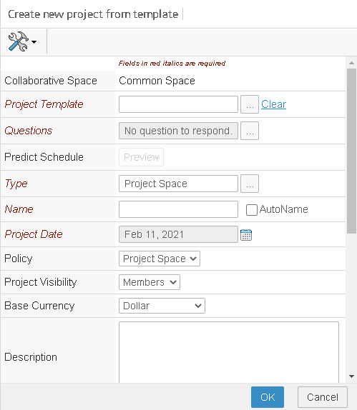
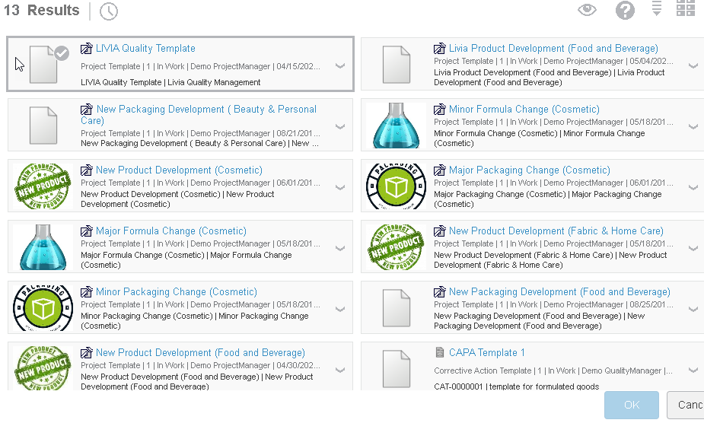
Create new Project Concept
Create a Project from Template
You can also create a Project from Template
Select Actions > From Template >
You can now select the Project Template from the Results and click OK
1
2
3

Slide 39
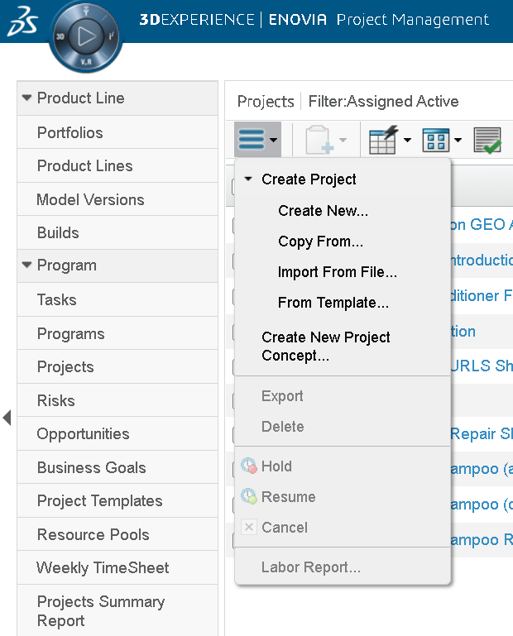
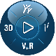
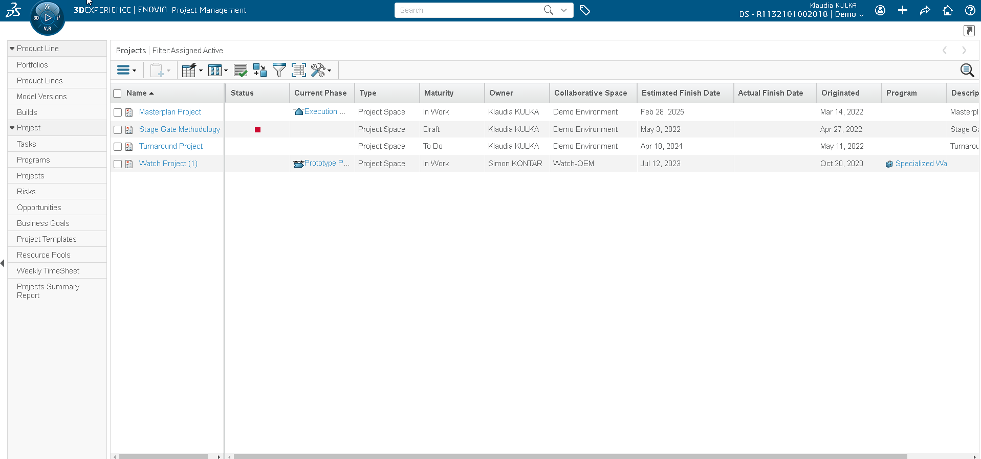
Create new Project Concept
Create a new Project
The Project List shows you the existing Projects
Select Actions > Create Project > Create New…

Slide 40
Project schedule
Schedule Project Activities
General overview on how Creating Projects
Modify Project Structure
Collaborative Tasks
Add Project Members and Task Assignees
1
2
3
4
Phase, Task, Gate, Milestone
Define Task Dependency
Team Members and Project Manager determine Assigned Tasks….
Manage Assignment
Modify the Project
5
Create Project Bookmarks
Add Deliverables
Define the Budget
Continue in the next Slide
8
7
6
Analyze Projects
Dashboard Views
Project Views
Across organizations
Assess performance KPIs
Select best path through scenario comparison
Schedule Status
Gantt Chart
Milestones
Phase Gate View
Baselines

Slide 41
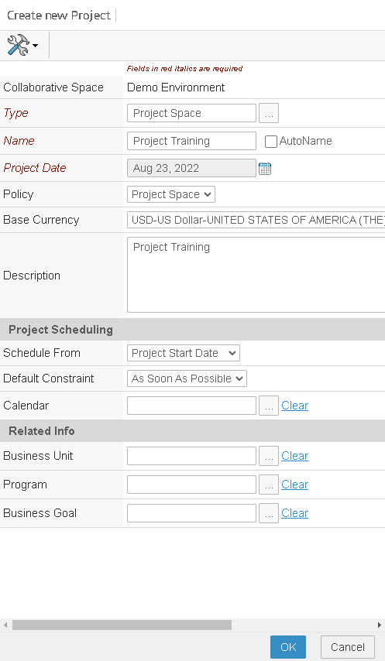
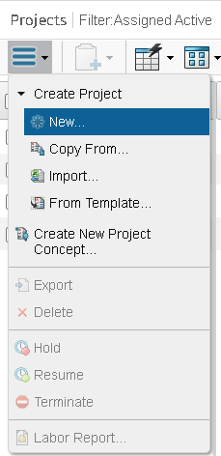
Modify Task Structure
Select Constraint type
Specify the following details, and click OK:
Type: Project Space
Name: “Project Training”
Project Date: (specify today‘s date)
Base Currency: USD-US Dollar
Description: „ Project Training“
Schedule From: Project Start Date
Default Constraint: As Soon As Possible
The Project is created.

Slide 42
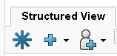
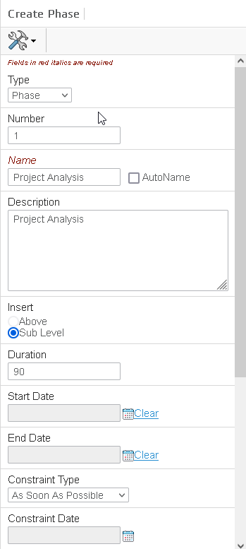
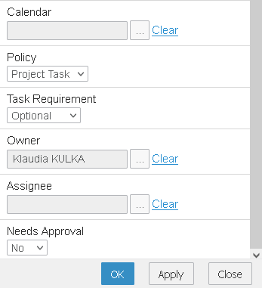
Modify Project Structure
Create a new Phase (Assignees will be detailed later on)
Create a new Task as a Phase, and click OK:
Type: Phase
Number: 1
Name: “Project Analysis”
Description: „Project Analysis“
Duration: 90 Days
Task Requirement: Optional
Constraint Type: As Soon As Possible
Assignee: Select a Assignee from the Pool
The Phase is created.
Create Task

Slide 43
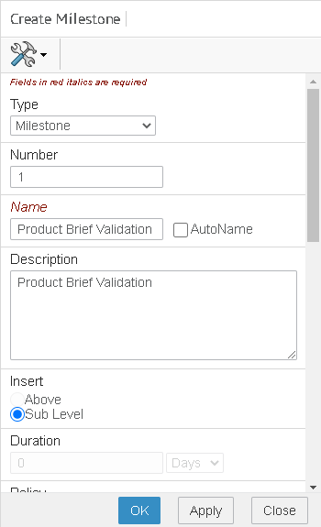
Modify Project Structure
Create a new Milestone (Assignees will be detailed later on)
Create a new Milestone, and click OK:
Type: Milestone
Number: 1
Name: “Product Brief Validation”
Description: „ Product Brief Validation“
Task Requirement: Optional
Constraint Type: As Soon As Possible
Assignee: Select a Assignee from the Pool
The Milestone is created.
Create Task

Slide 44
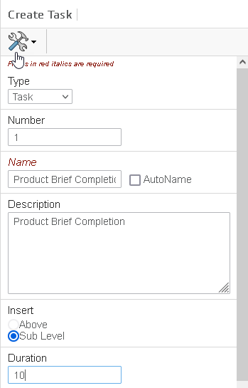
Modify Project Structure
Create a new Milestone (Assignees will be detailed later on)
Create a new Task as Gate, and click OK:
Type: Gate
Number: 1
Name: “Product Validation”
Description: „ Product Validation“
Task Requirement: Optional
Constraint Type: As Soon As Possible
Assignee: Select a Assignee from the Pool
The Gate is created.
Create Task

Slide 45
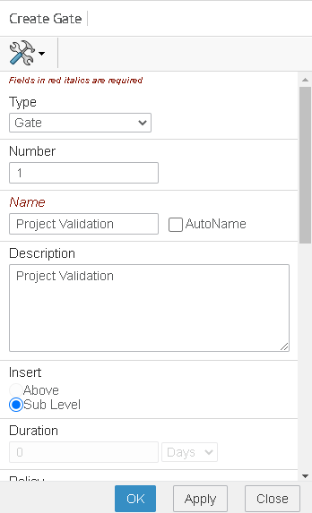
Modify Project Structure
Create a new Gate (Assignees will be detailed later on)
Create a new Task as Gate, and click OK:
Type: Gate
Number: 1
Name: “Product Validation”
Description: „ Product Validation“
Task Requirement: Optional
Constraint Type: As Soon As Possible
Assignee: Select a Assignee from the Pool
The Gate is created.
Create Task

Slide 46
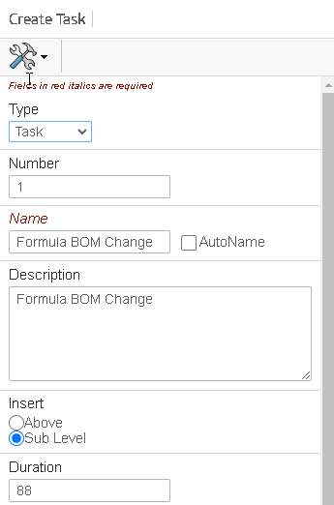
Modify Task Structure
Create a new Task (Assignees will be detailed later on)
Create one new Task, and click OK:
Click right mouse and Create Task
Number: 1
Name: “Formula BOM Change”
Description: „Formula BOM Change“
Duration: 88 Days
Task Requirement: Optional
Constraint Type: As Soon As Possible
Assignee: Select a Assignee from the Pool
The Task is created.
Repeat the same procedure with another one Task creation.
Create Task

Slide 47
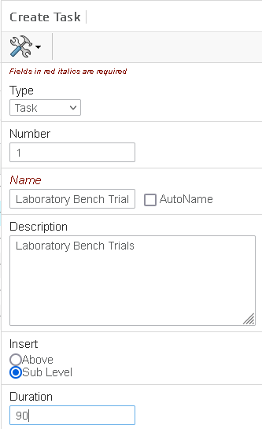
Modify Project Structure
Create a new Task by right mouse Click
Create one new Task, and click OK:
Click right mouse and Create Task
Number: 1
Name: “Laboratory Bench Trials”
Description: „ Laboratory Bench Trials“
Duration: 90 Days
Task Requirement: Optional
Constraint Type: As Soon As Possible
Assignee: Select a Assignee from the Pool
The Task is created.
Repeat the same with another one Task creation.
Create Task

Slide 48
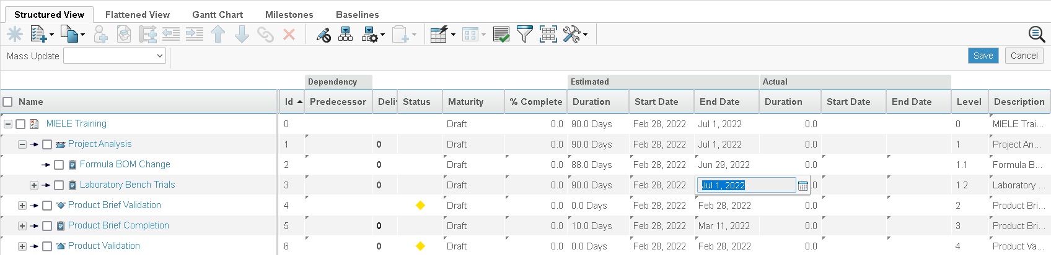
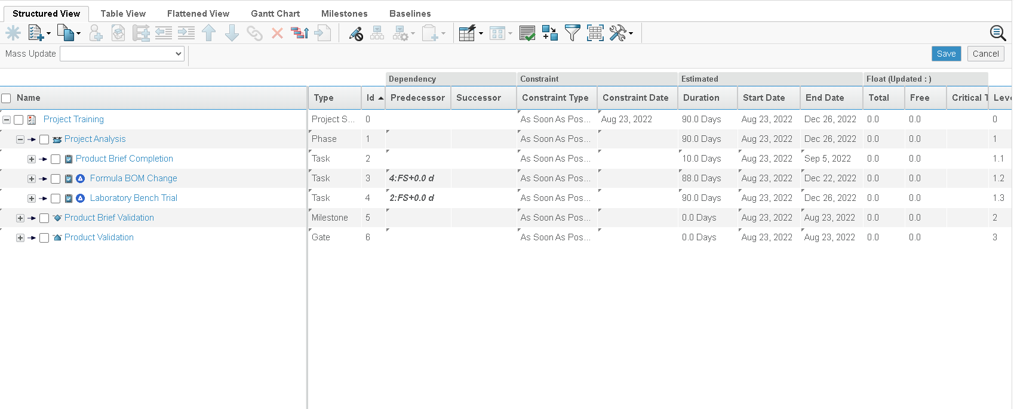
Modify Task Structure
Project details directly in the Project schedule
Rework of the Tasks
Enable Edit (Use the Pen)
You are able to change the Maturity, % Complete, Duration, Start and End Date etc.
Metabo Project

Slide 49
Define Task Dependency
Adding Schedule Task Dependencies mass process (1/3)
There are four types of dependencies:
(FS) Finish-to-Start: The selected task cannot start until this one finishes. This is the default task dependency.
(SS) Start-to-Start: The selected task cannot start until this task starts.
(FF) Finish-to-Finish: The selected task cannot finish until this task finishes.
(SF) Start-to-Finish: The selected task cannot finish until this task starts.
The following formula needs to be added in the Flattened View by Enable Edit (Use the Pen)
Predecessor 3:FS+0.0 d

Slide 50
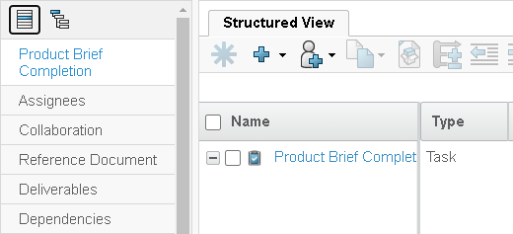
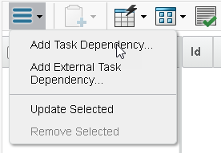
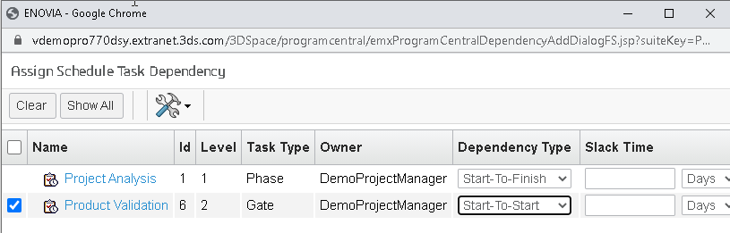
Define Task Dependency
Adding Schedule Task Dependencies mass process (2/3)
Rework of the Tasks dependencies
Click on the Task
Click Categories
Click on the Dependencies
Add Task Dependencies
You can modify the Dependency Type
Note: You can select the dependencies as:
Internal Dependency: You can add a dependency to the selected Task of the master project
External Dependency: You can add dependencies with the schedule tasks that belong to an external project.

Slide 51
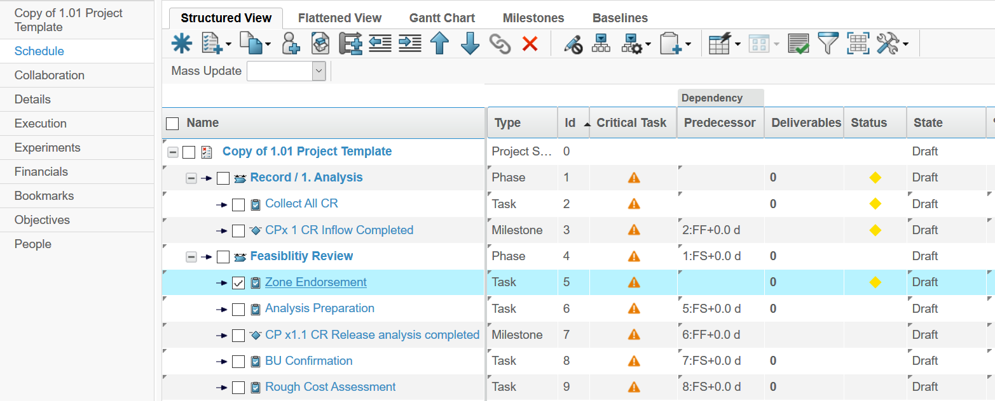
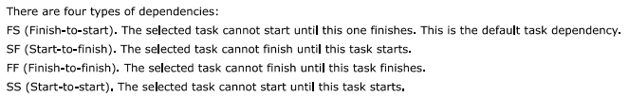
Task Dependency Views
View Dependencies in the Schedule View (3/3)

Slide 52

Project schedule
Schedule Project Activities
General overview on how Creating Projects
Modify a New Project
Collaborative Tasks
Add Project Members and Task Assignees
1
2
3
4
Phase, Task, Gate, Milestone
Define Task Dependency
Team Members and Project Manager determine Assigned Tasks….
Manage Assignment
Modify the Project
5
Create Project Bookmarks
Add Deliverables
Define the Budget
Continue in the next Slide
8
7
6
Analyze Projects
Dashboard Views
Project Views
Across organizations
Assess performance KPIs
Select best path through scenario comparison
Schedule Status
Gantt Chart
Milestones
Phase Gate View
Baselines

Slide 53
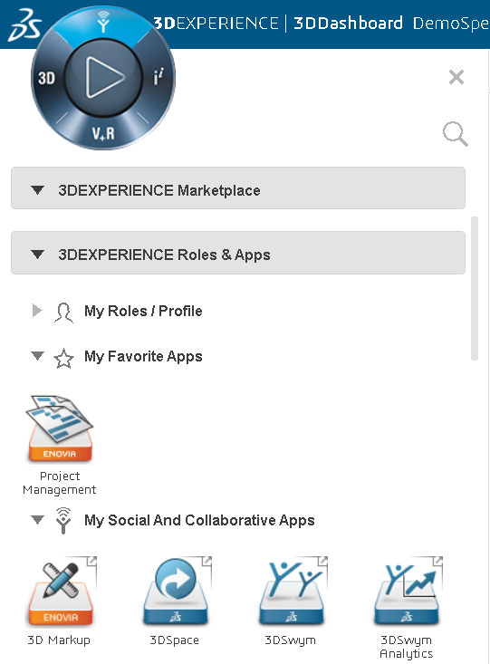

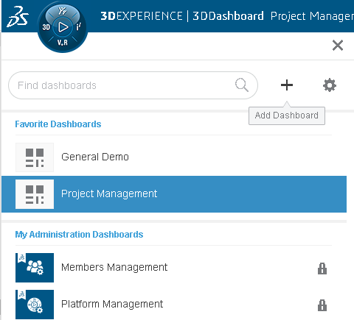




Modify Tasks in Collaborative Tasks Widget
Collaborative Tasks (1/5)
In the Compass, click My Social and Collaboration Apps
Expand the My Social and Collaboration Apps menu
Add a new Dashboard
Drag the ENOVIA Collaborative Tasks Widget to My Favorites
Drag the Collaborative Tasks Widget in the Tab
3
1
2

Slide 54

Modify Tasks in Collaborative Tasks Widget
Collaborative Tasks (2/5)
Search the “Project Training” Project
You can now view the prevoius created Tasks from your Project
1
2

Slide 55


Modify Tasks in Collaborative Tasks Widget
Collaborative Tasks (3/5)
Change the Maturity from “To Do” to “In Work”
You can change it directly in the Task edit mode or you can move the Task per drag and drop
1
2

Slide 56





Modify Tasks in Collaborative Tasks Widget
Collaborative Tasks (4/5)
You can edit the and define the following changes:
Percent Complete
Maturity
Estimated Dates
Estimated Duration
Attachments
Deliverables
Assignees
Co-owners
7
1
2
3
4
8
5
6

Slide 57


Modify Tasks in Collaborative Tasks Widget
Collaborative Tasks (5/5)
You can create new Tasks and define the parameter as described in the previous slide
You can change the View by…

Slide 58
Project schedule
Schedule Project Activities
General overview on how Creating Projects
Modify a New Project
Collaborative Tasks
Add Project Members and Task Assignees
1
2
3
4
Phase, Task, Gate, Milestone
Define Task Dependency
Team Members and Project Manager determine Assigned Tasks….
Manage Assignment
Modify the Project
5
Create Project Bookmarks
Add Deliverables
Define the Budget
Continue in the next Slide
8
7
6
Analyze Projects
Dashboard Views
Project Views
Across organizations
Assess performance KPIs
Select best path through scenario comparison
Schedule Status
Gantt Chart
Milestones
Phase Gate View
Baselines

Slide 59




Add Project Members and Task Assignees
Assign and Access
1
Enable Edit (Use the Pen) and generate the Access options
2

Slide 60
Project schedule
Schedule Project Activities
General overview on how Creating Projects
Modify a New Project
Collaborative Tasks
Add Project Members and Task Assignees
1
2
3
4
Phase, Task, Gate, Milestone
Define Task Dependency
Team Members and Project Manager determine Assigned Tasks….
Manage Assignment
Modify the Project
5
Create Project Bookmarks
Add Deliverables
Define the Budget
Continue in the next Slide
8
7
6
Analyze Projects
Dashboard Views
Project Views
Across organizations
Assess performance KPIs
Select best path through scenario comparison
Schedule Status
Gantt Chart
Milestones
Phase Gate View
Baselines

Slide 61





Modify the Project
Create Bookmarks in Project
1
2
3
4
Add Documents
Per drag and drop from your explorer
From the Search
5

Slide 62


Modify the Project
Connect the Project Bookmark with the Bookmark Editor
1
2

Slide 63
Project schedule
Schedule Project Activities
General overview on how Creating Projects
Modify a New Project
Collaborative Tasks
Add Project Members and Task Assignees
1
2
3
4
Phase, Task, Gate, Milestone
Define Task Dependency
Team Members and Project Manager determine Assigned Tasks….
Manage Assignment
Modify the Project
5
Create Project Bookmarks
Add Deliverables
Define the Budget
Continue in the next Slide
8
7
6
Analyze Projects
Dashboard Views
Project Views
Across organizations
Assess performance KPIs
Select best path through scenario comparison
Schedule Status
Gantt Chart
Milestones
Phase Gate View
Baselines

Slide 64

Project Views
Modification of the Project details directly in the Project schedule (1/3)
Rework of the Project Members
Click on the Allocation View
You are able to assign the percentage of the Project Members directly in the Schedule

Slide 65


Project Views
Modification of the Project details directly in the Project schedule (2/3)
Rework of the Project Members
Click on the Assignment View
You are able to assign the percentage of the Project Members directly in the Schedule

Slide 66


Project Views
Modification of the Project details directly in the Project schedule (3/3)
Rework of the Project Members
Click on the Task Schedule View
You are able to change the Maturity etc. directly in the Schedule

Slide 67
Project schedule
Schedule Project Activities
General overview on how Creating Projects
Modify a New Project
Collaborative Tasks
Add Project Members and Task Assignees
1
2
3
4
Phase, Task, Gate, Milestone
Define Task Dependency
Team Members and Project Manager determine Assigned Tasks….
Manage Assignment
Modify the Project
5
Create Project Bookmarks
Add Deliverables
Define the Budget
Continue in the next Slide
8
7
6
Analyze Projects
Dashboard Views
Project Views
Across organizations
Assess performance KPIs
Select best path through scenario comparison
Schedule Status
Gantt Chart
Milestones
Phase Gate View
Baselines

Slide 68


Dashboard Views
Intuitive project metrics for better decision making
Project execution metrics and business metrics
Project status tiles provides a quick status of the project
Detailed charts on project execution
Charts on Top Level Task, All Tasks, Deliverable, Critical Tasks
Gantt view of the summary tasks
Burn-down Chart: Displays the measurable progress of the project over time
Detailed charts on project schedule
Charts on Top Level Task, All Tasks, Deliverable, Critical Tasks
Gantt view of the summary tasks
Burn-down Chart: Displays the measurable progress of the project over time
Detailed charts on business aspect of the project
Budget and Benefits charts provide the periodic trend of the Estimated vs Actuals
Risk Grid shows the number of risk across the risk spectrum (low to high)
Charts on Issues and Assessments

Slide 69



Dashboard Views
Gantt Chart, Milestones and Phase Gate View

Slide 70

Dashboard Views
Gantt Chart (1/3)
A Gantt Chart Viewer shows the graphical representation of the project schedule. It enables you to view the project’s schedule tasks and milestones along with their dependencies in the standard Gantt notation.
The Gantt Chart Viewer includes the following:
A Gantt Chart is divided into two sections. The left section is a table structure and the right section is a Gantt Chart sheet.
The table section shows the task structure and ist attributes.
The right section shows the Gantt sheet with graphically represents the time line and dependencies between individual tasks.

Slide 71


Dashboard Views
Gantt Chart (2/3)
Reveal schedule properties with advanced filtering & coloring and directly edit tasks
User filters Gantt Chart view based on exposed tasks attributes (State, Owner, Date Ranges, …)
User search for Tasks within the Gantt Chart
Display Critical path
Gantt Print capabilities
Directly edit tasks in the Gantt view to change/add schedule
Start and End date
Duration
Dependencies
Save or rollback the changes

Slide 72
Dashboard Views
Gantt Chart (3/3)
1
Highlight Critical Path
2
Calculate Float and Critical Path
3
Progress Line

